Slide 1
Evaluating Low-Dose Quetiapine in the Prevention of Transition to Psychosis in Severe Clinical High-Risk Individuals
Group 6: Warren Szewczyk, Natalie Wu, Ivy Zhang, Qin Li

Slide 2
Background on Psychosis and Health Burden
Psychosis confers considerable burden on those who experience this disorder
High risk individuals can be identified before development of severe symptoms
Strong need to rigorously test interventions to delay or avert transition to psychosis
Notes:
Experiencing psychosis confers considerable burden on patients - social, familial, occupational, and physical function are all affected
Strong need for reliable interventions in CHR to delay or avert transition to psychosis

Slide 3
Partnership with Kaiser Permanente
Kaiser Permanente Washington Health Research Institute (KPWHRI)
Robust research institute
Collaboratively developed partnership with national KP system
Will allow for sufficient power to reliably determine whether an effect exists
Notes:
Ongoing COVID-19 variant clinical trial

Slide 4
Study Population
Individuals identified as severe clinical high-risk (CHR) for psychosis
Recruit participant through Kaiser health system (6 sites)
- one major pathway: provider referral
Participant retention goal: 65%
Participant withdrawal
Notes:
One major pathway for recruitment will be provider referral.
Participants may voluntarily withdraw from the study for any reason at any time by withdrawing informed consent.
The Investigator may withdraw participants from the treatment intervention in order to protect their safety after consultation with a team of the research group.
For the protection of the withdrawn participant he/her has to be offered follow-up care.

Slide 5
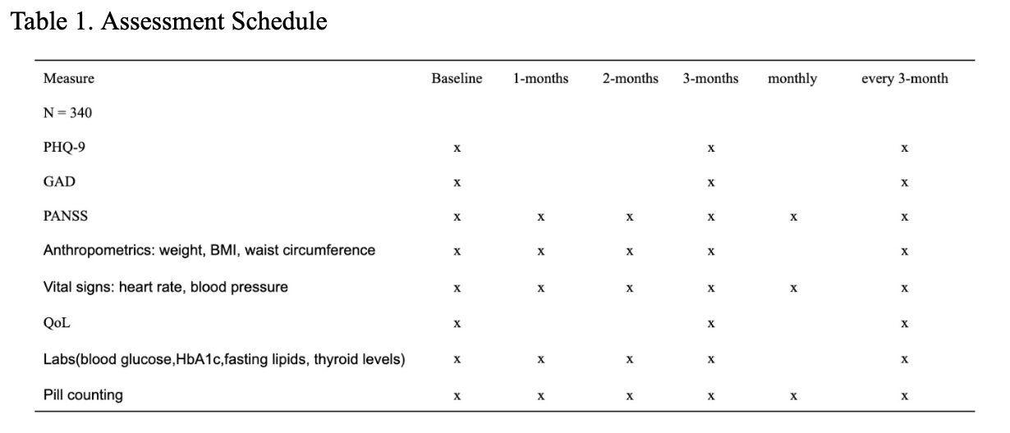
Study Design
Assessment
Notes:
Each participant will attend a clinical visit after screening to finish baseline assessment at the clinic

Slide 6
Study Design
2-arm, double-blind, placebo-controlled randomized trial with 1:1 allocation of treatment to control.
Time to Event Analysis
Primary Endpoint: Time to transit to FEP
Defined as PANSS scores over 58
Track Monthly
Secondary Endpoint: SF-36 scores

Slide 7
Study Design
Intervention & controls
Intervention: Low dose Quetiapine (200 mg/day) from Seroquel
Placebo: pills of the same appearance as the intervention pills
Adherence: pill counting
Notes:
two groups will follow same instructions.
Participants will be randomized at a 1:1 ratio of quetiapine + NBI to placebo + NBI. Randomization will be stratified by clinical site and blocked by time.

Slide 8
Statistical Considerations
Sample Size:
Aimed of 66 events
To detect 50% reduction with the power of 0.8
340 participants need to be randomized
Placebo group: 40% ; Treatment group: 20%
Adjust for the retention rate
Interim Analysis after collecting about 50% of the events

Slide 9
Statistical Considerations
Randomness & Blindness:
1:1 randomization made by Interactive Web Response System
Receive either placebo or quetiapine
Pills are identical in appearance
Participants, study site investigators, study staff, or site monitors will not be aware of the study intervention assignments
Unblinded rationale monitored by DSMB
Notes:
DSMB: Data & Safety Monitoring Board

Slide 10
Statistical Considerations
Data Analysis:
Primary Data Analysis
Cox Proportional Model
Log-Rank Test (2 side significance level of 0.05)
Interim Analysis at 33 events
Reject null hypothesis if p-value is less than 0.08
gsDesign Package from R
Notes:
DSMB: Data & Safety Monitoring Board

Slide 11
Statistical Considerations
Data Analysis:
Secondary Data Analysis
T-test will be applied to examine whether there is a difference between the two treatment groups
Sincerely apologize for the typo in the written proposal
Comparing the SF-36 scores at the baseline and after 36 months
Notes:
DSMB: Data & Safety Monitoring Board

Slide 12
Ethics
Informed Consent will be obtained after explaining the study
Incentives: baseline visit: $100; 3-month visit: $80; each year: $100;
Total: $850
All laboratory specimens, reports, study data collection, process, and administrative forms will be identified by a coded number only to maintain participant confidentiality.
Notes:
DSMB: Data & Safety Monitoring Board

Slide 13
Safety Monitoring
Quetiapine is generally considered safe but does carry risk of side effects
Unsafe for some groups (pregnant, cardiac arrhythmia)
More intensive safety monitoring will be conducted in the first few months of participant involvement
Independent DSMB will be arranged to monitor safety issues

Slide 14
Data Monitoring
Purpose: ensure that the clinical sites comply with the study protocol and regulatory requirements
Kaiser will provide a third party data monitoring committee
Use direct data entry of clinical trial data, and store in EDC system
Notes:
This study will use direct data entry of clinical trial data. This process allows a clinical study site to perform direct data entry of original data into electronic data capture (EDC) at the time of the subject’s office visit, and for the original data to be stored in PDF format in the access-controlled data repository, access to which is controlled by the clinical Investigator or designee

Slide 15
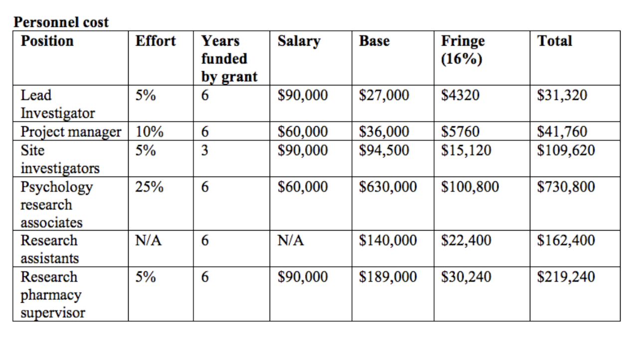
Budget

Slide 16
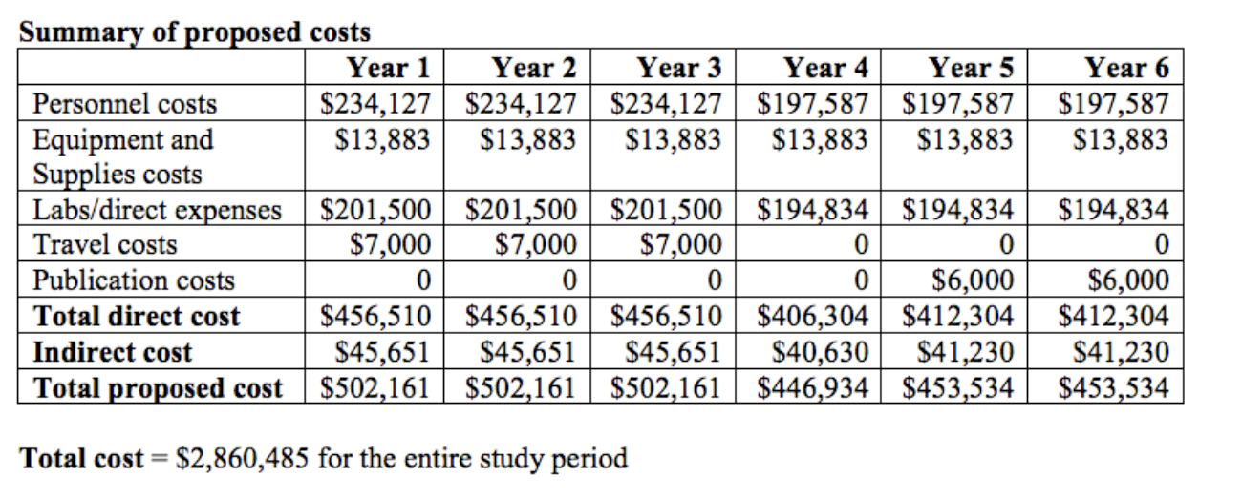
Budget

Slide 17
Questions?
Thank you!

